Slide 1


Slide 2
MapD & H2O.ai: GPU-powered Visualization, Data Analysis and Machine Learning
Ashish Sahu, VP of Product, MapD
Mateusz Dymczyk, Software Engineer, H2O.ai
Twitter: @MapD
Email: info@mapd.com
Website: mapd.com

Slide 3


MapD: software optimized for the fastest hardware
CPU Processing
(Traditional)
GPU Processing
39,936 Cores
20 Cores

Slide 4
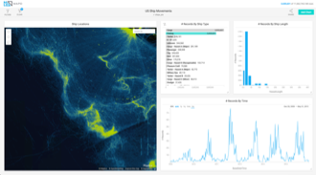
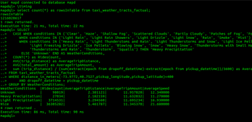
MapD: software optimized for the fastest hardware
100x Faster Queries
Visualization at the Speed of Thought
+
MapD Core
MapD Immerse
The world’s fastest
analytical database, powered by GPUs
A visualization front end that leverages the speed & rendering superiority of GPUs

Slide 5




Query Compilation with LLVM
Traditional DBs can be highly inefficient
each operator in SQL treated as a separate function
incurs tremendous overhead and prevents vectorization
MapD compiles queries w/LLVM to create one custom function
Queries run at speeds approaching hand-written functions
LLVM enables generic targeting of different architectures (GPUs, X86, ARM, etc).
Code can be generated to run query on CPU and GPU simultaneously
10111010101001010110101101010101
00110101101101010101010101011101

Slide 6
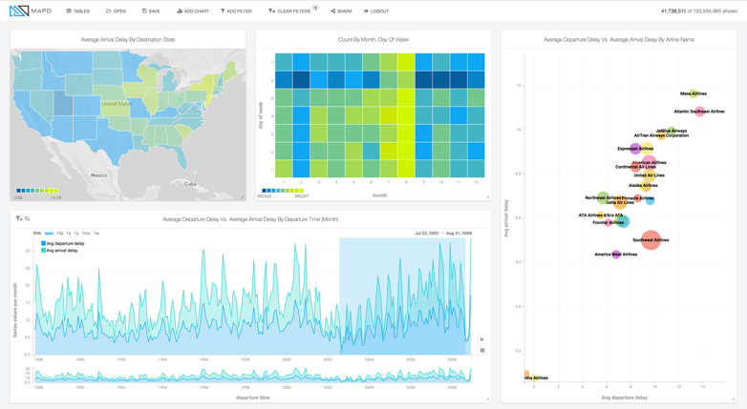
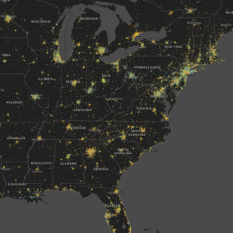
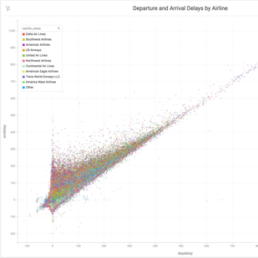
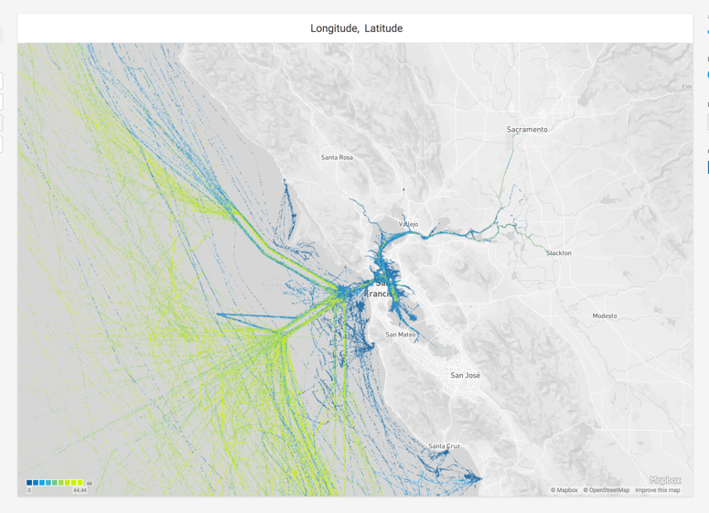
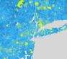


MapD Immerse: our hybrid approach
Basic charts are frontend rendered using D3 and other related toolkits
Scatterplots, pointmaps + polygons are backend rendered using the Iris Rendering Engine on GPUs
Geo-Viz is composited over a frontend rendered basemap

Slide 7
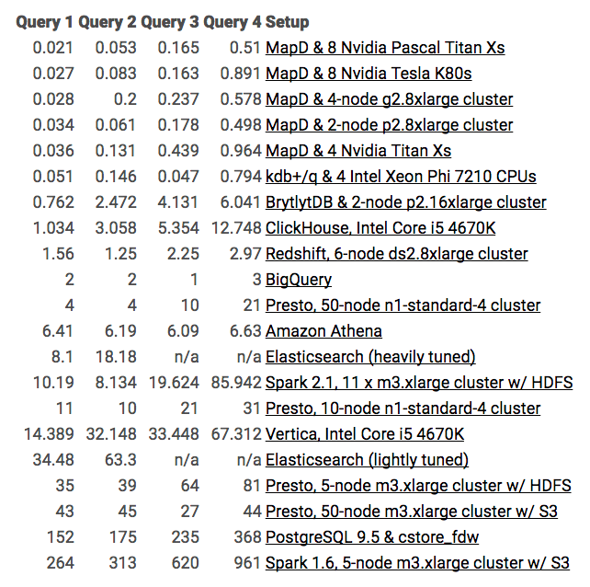
MapD queries are orders of magnitude faster
Blogger Mark Litwintschik benchmarked MapD on a billion-row taxi data set and found it to be up to orders-of-magnitude faster than the fastest CPU databases
MapD Core: Comparative Query Acceleration*
System | Query 1 | Query 2 | Query 3 | Query 4
BrytlytDB & 2-node p2.16xlarge cluster | 36x | 47x | 25x | 12x
ClickHouse, Intel Core i5 4670K | 49x | 58x | 32x | 25x
Redshift, 6-node ds2.8xlarge cluster | 74x | 24x | 14x | 6x
BigQuery | 95x | 38x | 6x | 6x
Presto, 50-node n1-standard-4 cluster | 190x | 75x | 61x | 41x
Amazon Athena | 305x | 117x | 37x | 13x
Elasticsearch (heavily tuned) | 386x | 343x | n/a | n/a
Spark 2.1, 11 x m3.xlarge cluster w/ HDFS | 485x | 153x | 119x | 169x
Presto, 10-node n1-standard-4 cluster | 524x | 189x | 127x | 61x
Vertica, Intel Core i5 4670K | 685x | 607x | 203x | 132x
Elasticsearch (lightly tuned) | 1,642x | 1,194x | n/a | n/a
Presto, 5-node m3.xlarge cluster w/ HDFS | 1,667x | 735x | 388x | 159x
Presto, 50-node m3.xlarge cluster w/ S3 | 2,048x | 849x | 164x | 86x
PostgreSQL 9.5 & cstore_fdw | 7,238x | 3,302x | 1,424x | 722x
Spark 1.6, 5-node m3.xlarge cluster w/ S3 | 12,571x | 5,906x | 3,758x | 1,884x
Source: http://tech.marksblogg.com/benchmarks.html
*All speed comparisons are to the “MapD & 1 Nvidia Pascal DGX-1” benchmark

Slide 8
*All speed comparisons are to the “MapD & 1 Nvidia Pascal DGX-1” benchmark

Slide 9







The Status Quo Pre-GOAI
Memory Hierarchy bottlenecks
PCIe
4-16GB/s

Slide 10










GPU Open Analytics Initiative (GOAI)
Standard In-Memory Format, Zero-Copy Interchange
GPU
Notes:
Cobbling together disparate tools is not the answer.

Slide 11
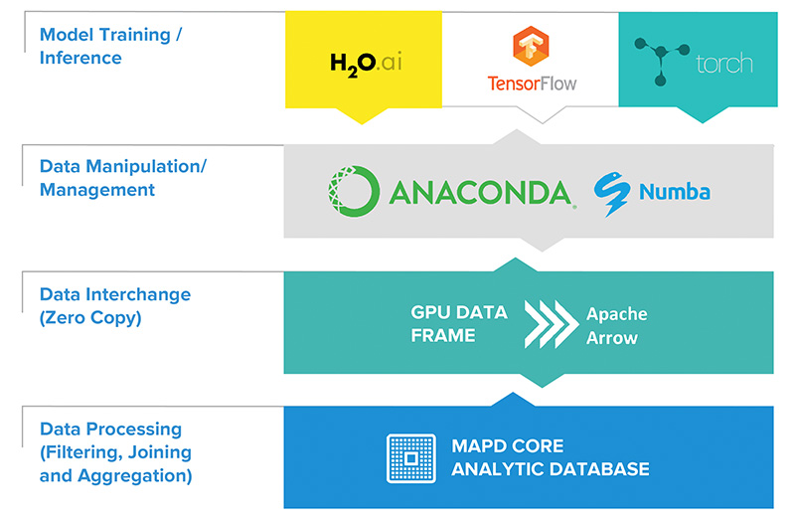
The Heart of GOAI: The GPU Data Frame (GDF)

Slide 12
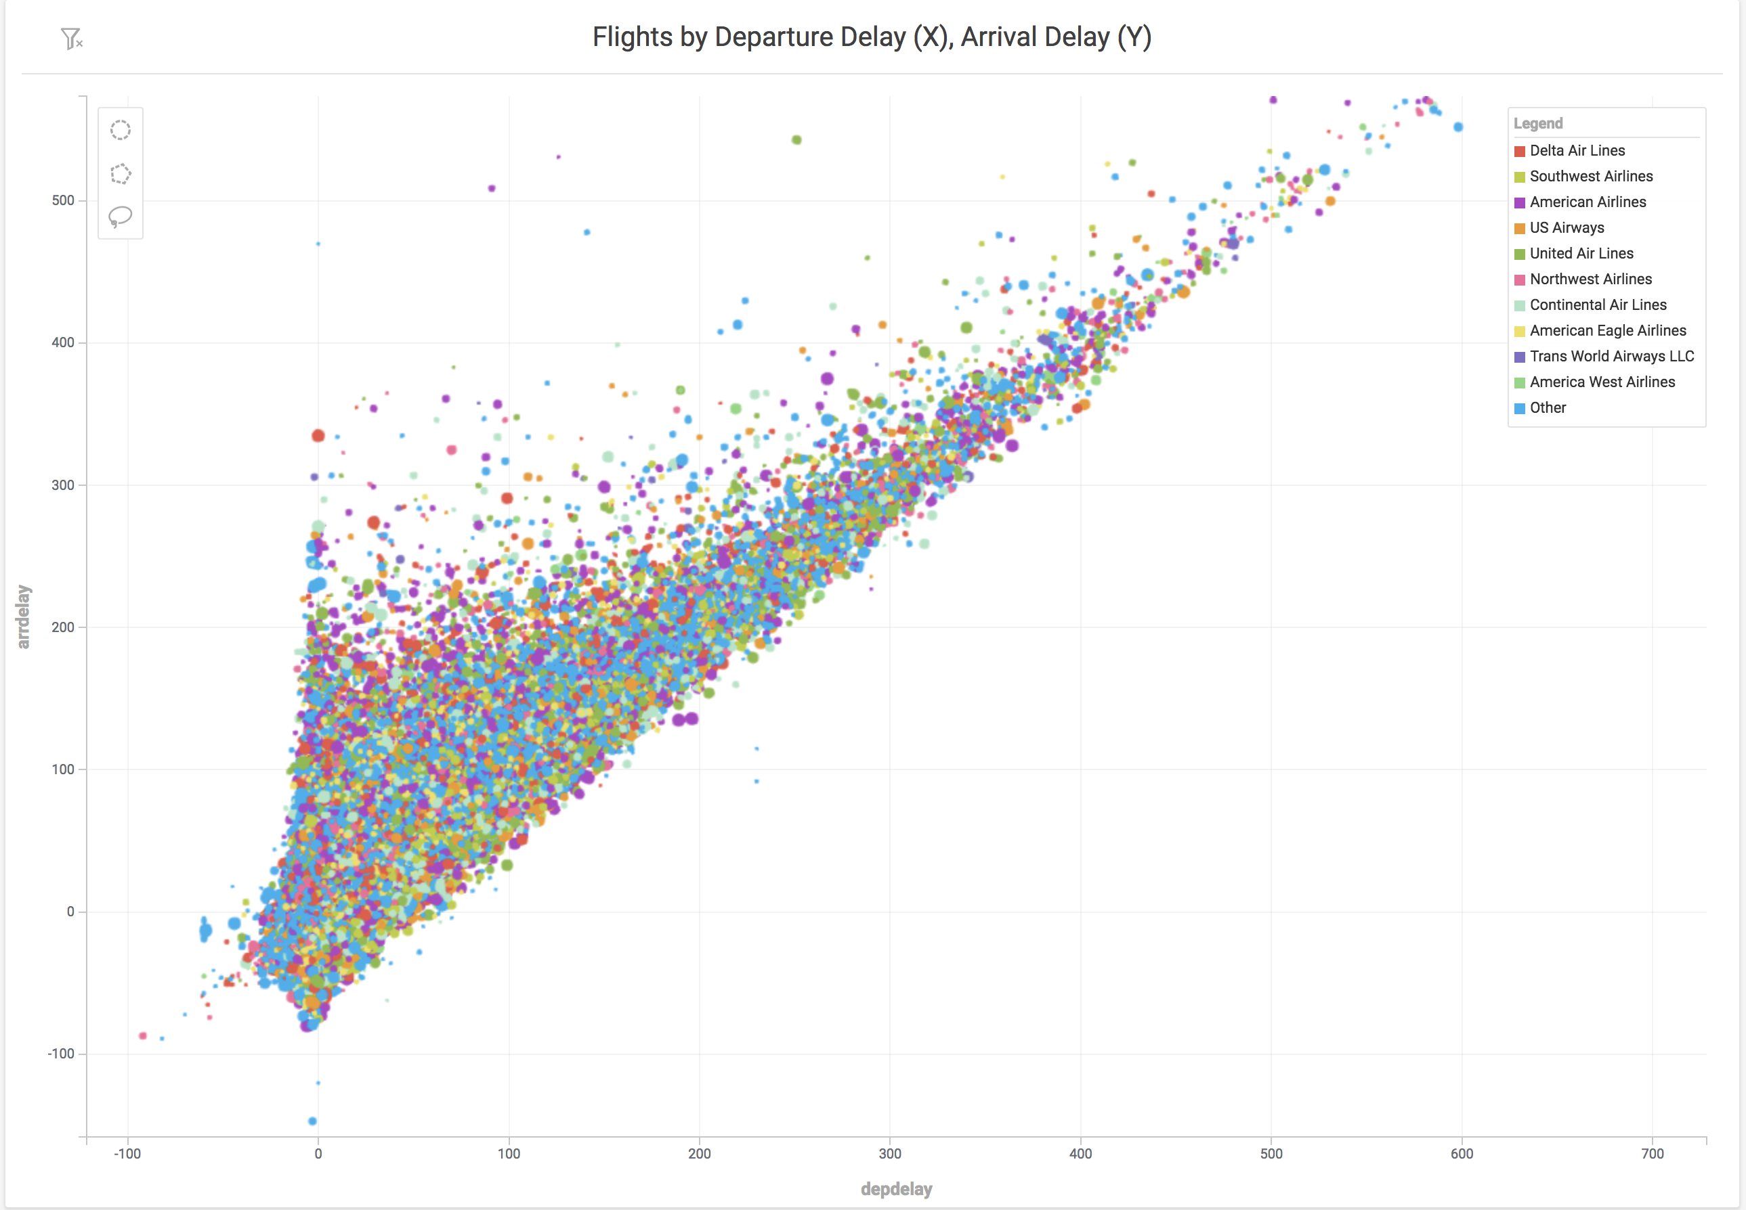
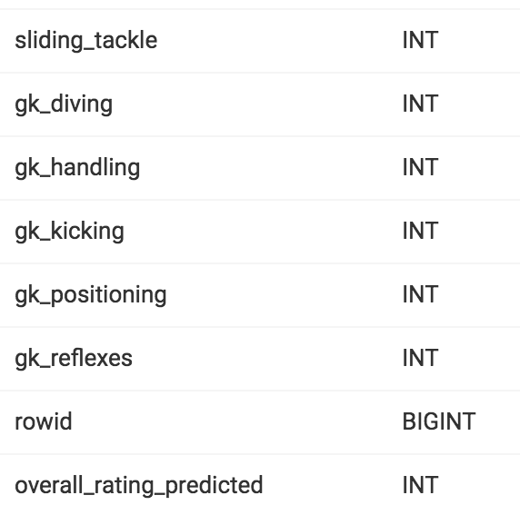
GPU Data Frame (GDF) Use Cases
AI
Interactive Feature
Engineering
Interrogating Black
Box AI
Enrich data with
pre-trained models
Leverage fast SQL and visualization to determine salient features and remove outliers
Identify correlates between inputs and outputs of model
ML/AI models can be used to augment and add predicted attributes to existing data

Slide 13
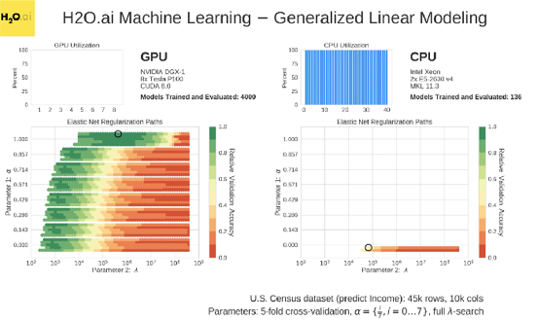
H2O4GPU - ML on GPUs
GPU acceleration to achieve up to 40x speedups vs CPU
Multi GPU - XGBoost, GLM, K-Means and more
Achieve best performance in shortest time

Slide 14
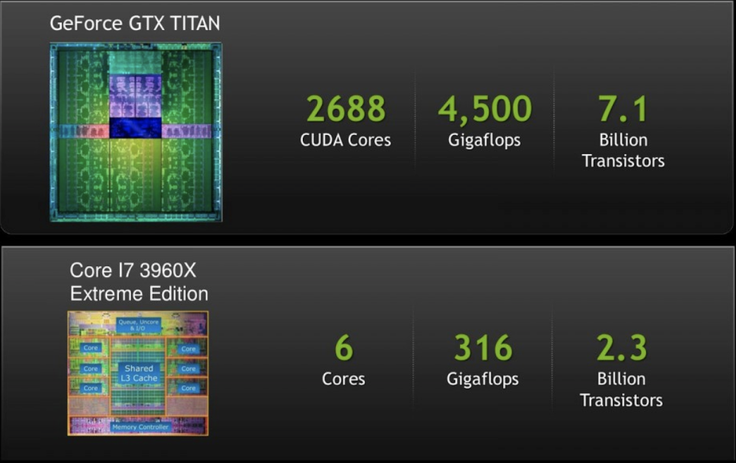
H2O4GPU - Why ML on GPU
 | Latency | Throughput
CPU | 1 ns per task | (1 task/ns) x (6 cores) = 6 tasks/ns
GPU | 10 ns per task | (0.1 task per ns) x (2000 cores) = 200 task per ns
Latency: Time to do a task. | Throughput: Number of tasks per unit time.
*fictitious example

Slide 15
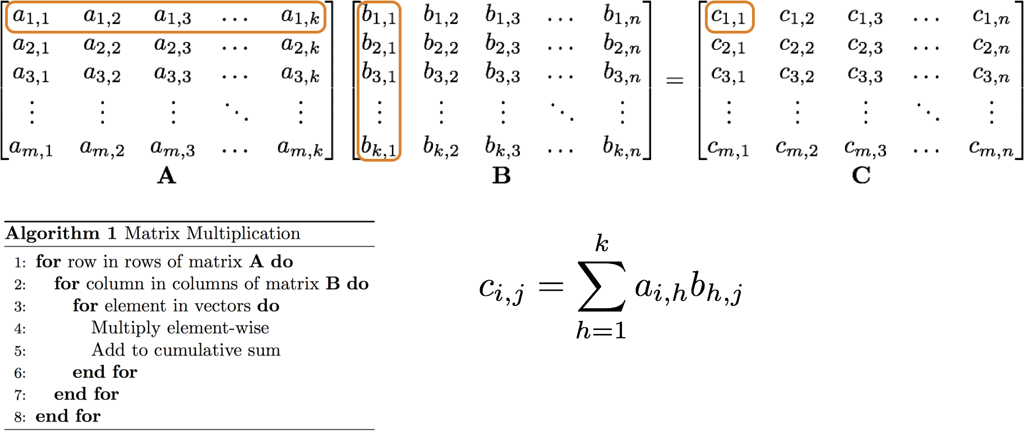
H2O4GPU - Why ML on GPU
Matrix operations = many small operations
Highly parallelizable
Perfect for GPUs
Machine Learning algorithms heavily rely on vector/matrix operations

Slide 16
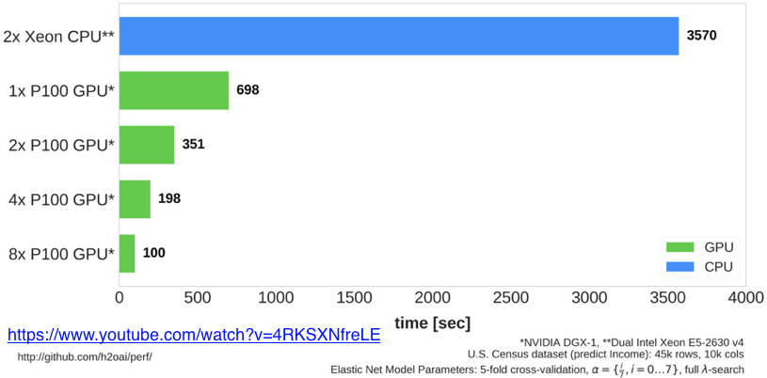
H2O4GPU - GLM Time to Train and Evaluate 4000 Models

Slide 17
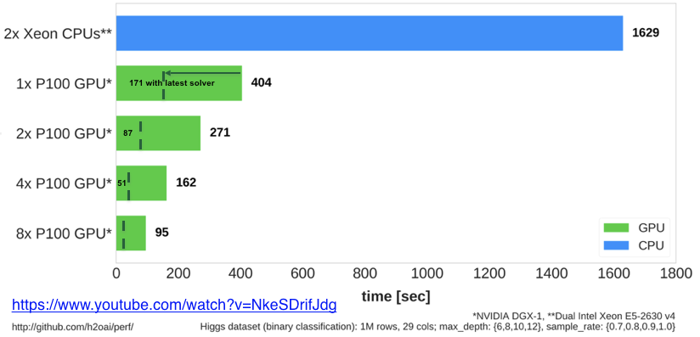
H2O4GPU - GBM Time to Train and Evaluate 16 H2O XGBoost Models

Slide 18
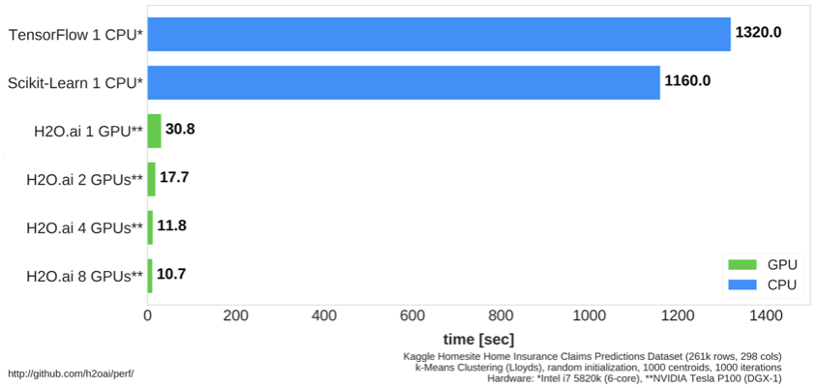
H2O4GPU - K-Means Time to run 1000 Lloyds iterations for k=1000

Slide 19
DEMO

Slide 20
Interactive Machine Learning Tailored Environments & Personas in Data Science Lifecycle
MapD
H20.ai
MapD
GPUs
Data Preparation
Data Discovery & Feature Engineering
Model & Validate
Predict Operationalize
Monitoring & Refinement
Evaluate & Decide
Data Engineer
Personas in Analytics Lifecycle (Illustrative)
Business Analyst
Data Scientist
IT Systems Admin
Data Scientist / Business Analyst

Slide 21
MapD Use Cases

Slide 22






Common use cases Powering analytics applications beyond the limits of CPUs
FINANCIAL SERVICES
Trading model generation
Real-time Risk
Fraud Anomaly Detection
TELECOMMUNICATIONS
Predictive Network Performance
Customer Churn
FEDERAL
Geo-analytics
Cyber-security
ENERGY
Dynamic Oil Well Management
TELEMATICS
Real-time fleet management
Incentive-based insurance
ADTECH
Segmentation analytics

Slide 23


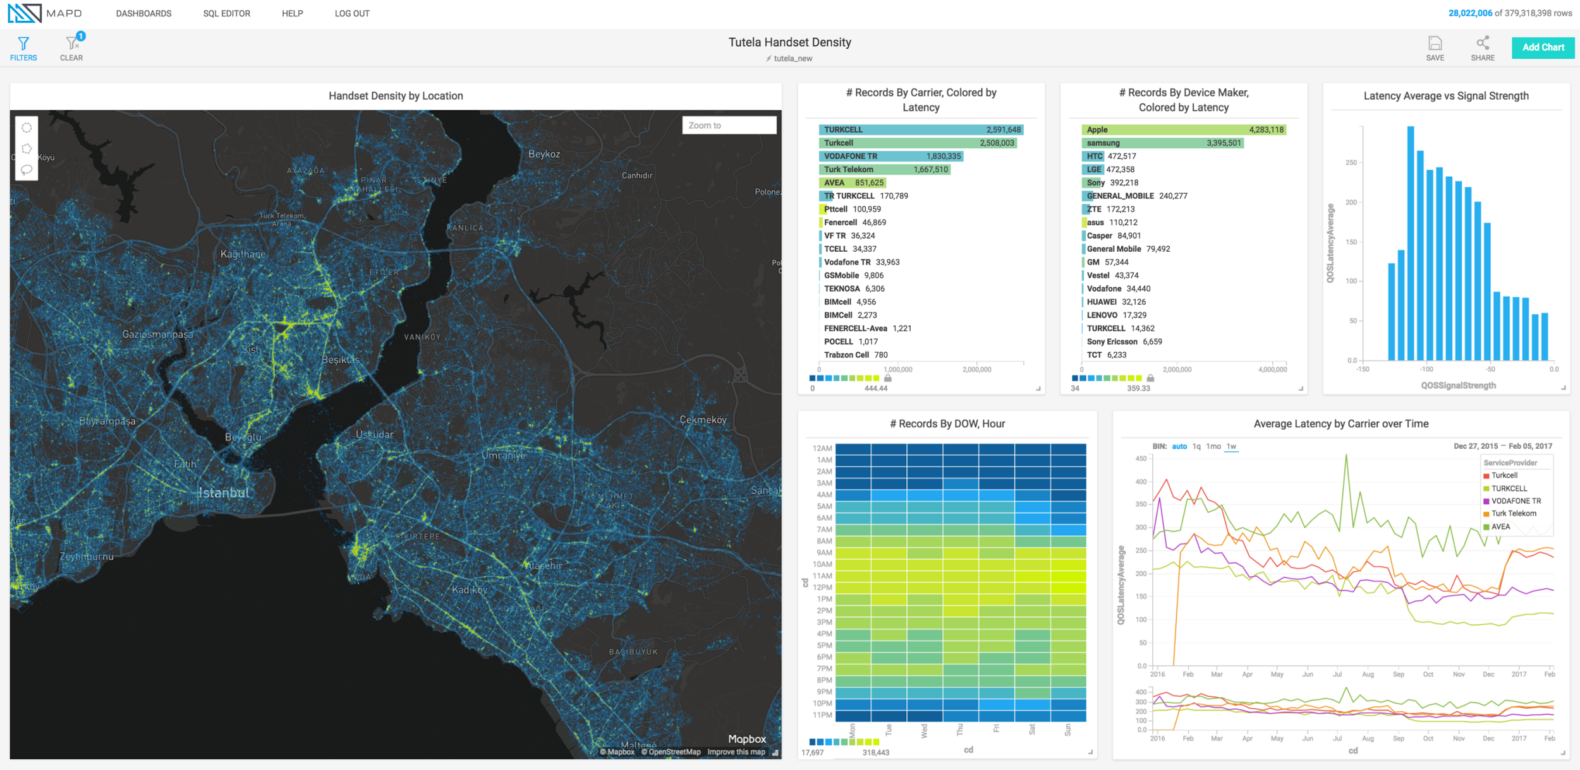
How is MapD being used? Verizon Wireless - Valuing speed and visualization
How does interactive analysis with MapD Immerse allow Verizon to improve System Health?
Ease & Speed of Interactivity allowed analysts to see patterns of previously unknown issues using visual data
Macro view: Bird’s eye view of patterns – can see both data over 1 month vs. 1 day
Individual device events: Amongst billions of events, see patterns of events and drill down to single event
Note: Example MapD Immerse dashboard pictured. This is NOT representative of an actual Verizon dashboard.

Slide 24

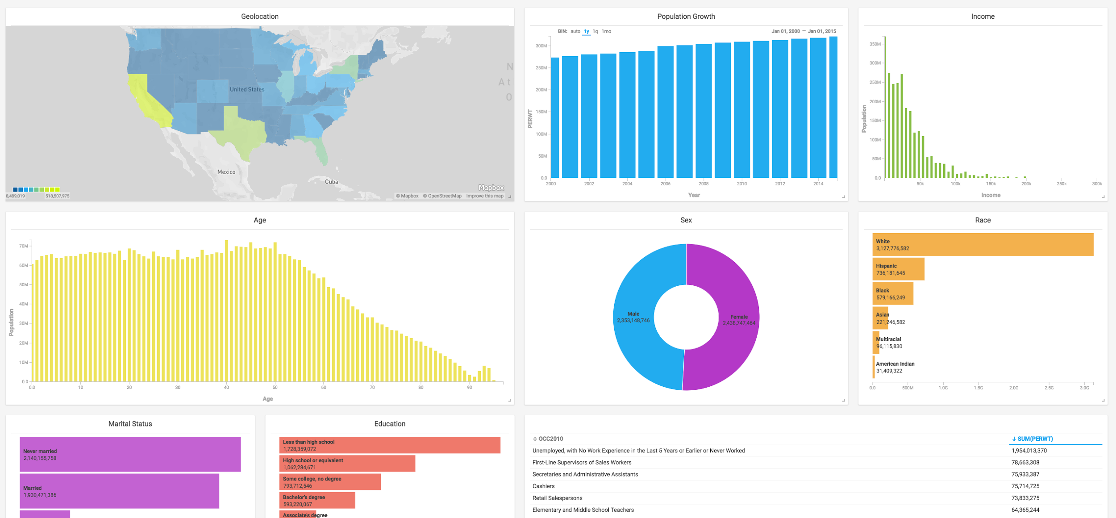
How is MapD being used? Simulmedia – Exploring Target Audience Segmentation & Ad Delivery Performance
How does MapD solve Simulmedia’s analytics challenge of slow
query times & ability to explore data freely?
Running complex queries on American TV behavior & demographic data in real-time for customers to drive insights & ad-buys
Democratizing real-time data discovery: Sales & clients team able to analyze data with their prospects & customers without the help of the engineering team
Speed-of-thought interactivity: Able to zoom into different audience segments by media market without waiting for queries to run
Note: Example MapD Immerse dashboard pictured.
This is NOT representative of an actual Simulmedia dashboard.

Slide 25













MapD Customers

Slide 26
H2O.ai Use Cases

Slide 27
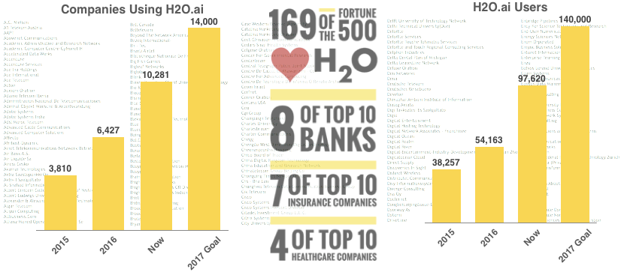
How is H2O.ai being used?

Slide 28


How is H2O.ai being used? Financial services
IT Infrastructure
Wholesale / Commercial Banking
Security Cyberlake
DoS Detection and Protection
Master Data Management
Know Your Customers (KYC)
Anti-Money Laundering (AML)
Retail Banking
Card/Payments Business
Deposit Fraud
Customer Churn Prediction
Auto-Loan
Transaction Frauds
Real-time Targeting
Credit Risk Scoring
In-Context Promotion

Slide 29
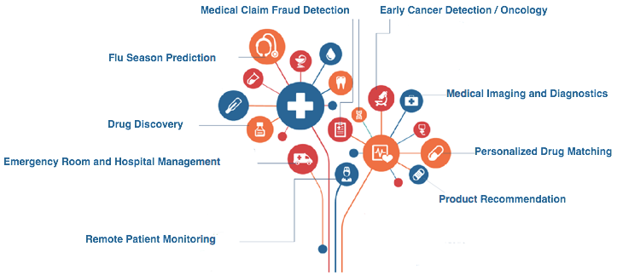

How is H2O.ai being used? Healthcare

Slide 30
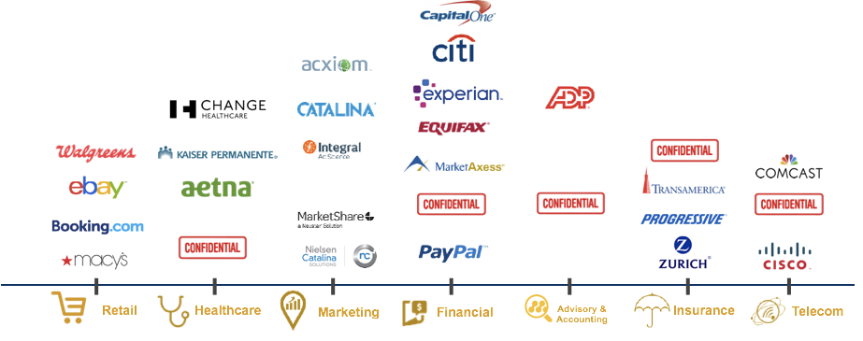
H2O.ai (select) Customers

Slide 31
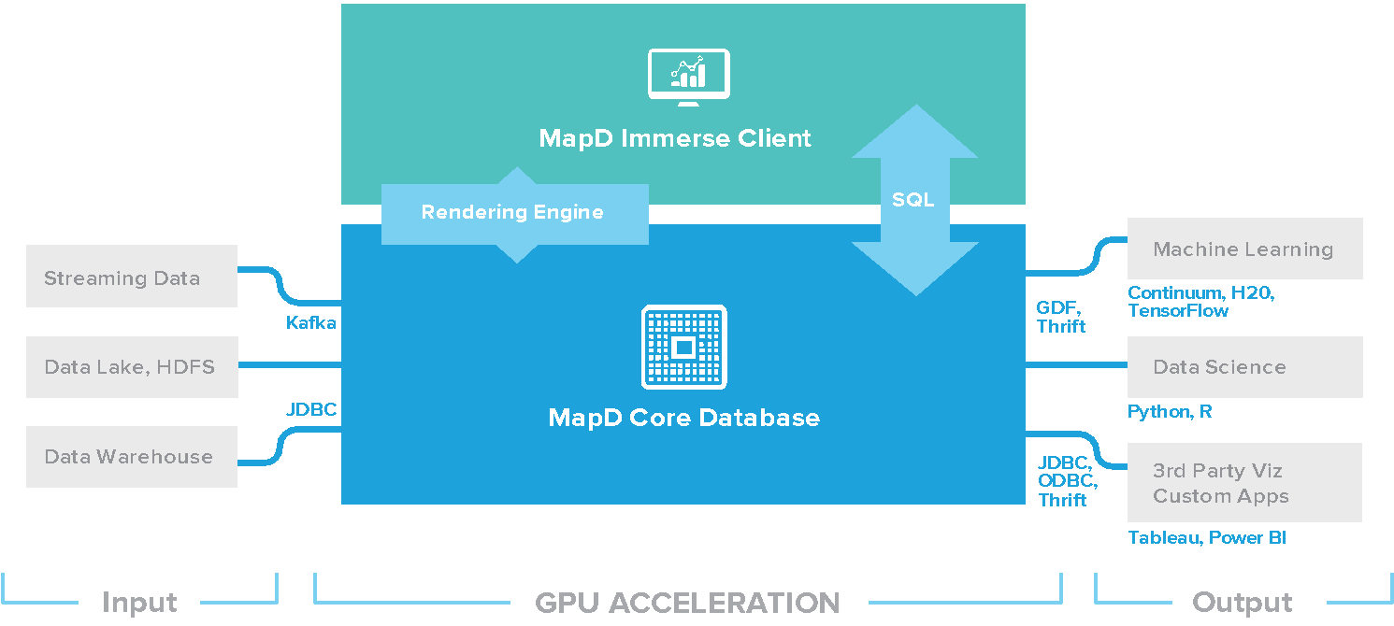
Where does MapD fit in?
MapD accelerates your existing data infrastructure

Slide 32

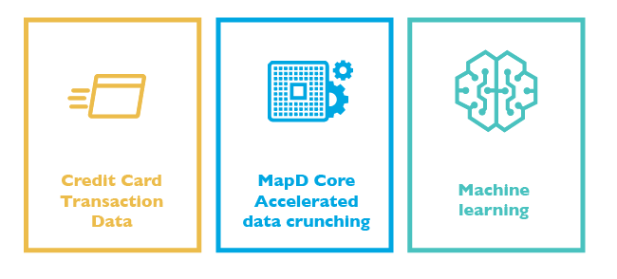
How is MapD being used? Hedge funds – building trading models in real-time
Mining credit card transactions with
MapD Core and real-time integration with research tools.
A global hedge fund uses the MapD Core database to mine incoming credit card transaction data to speed the construction of trading models
Performance Drives Value: More up-to-date models means more profitable trades
CPUs could not scale: Redshift hit performance scaling wall

Slide 33
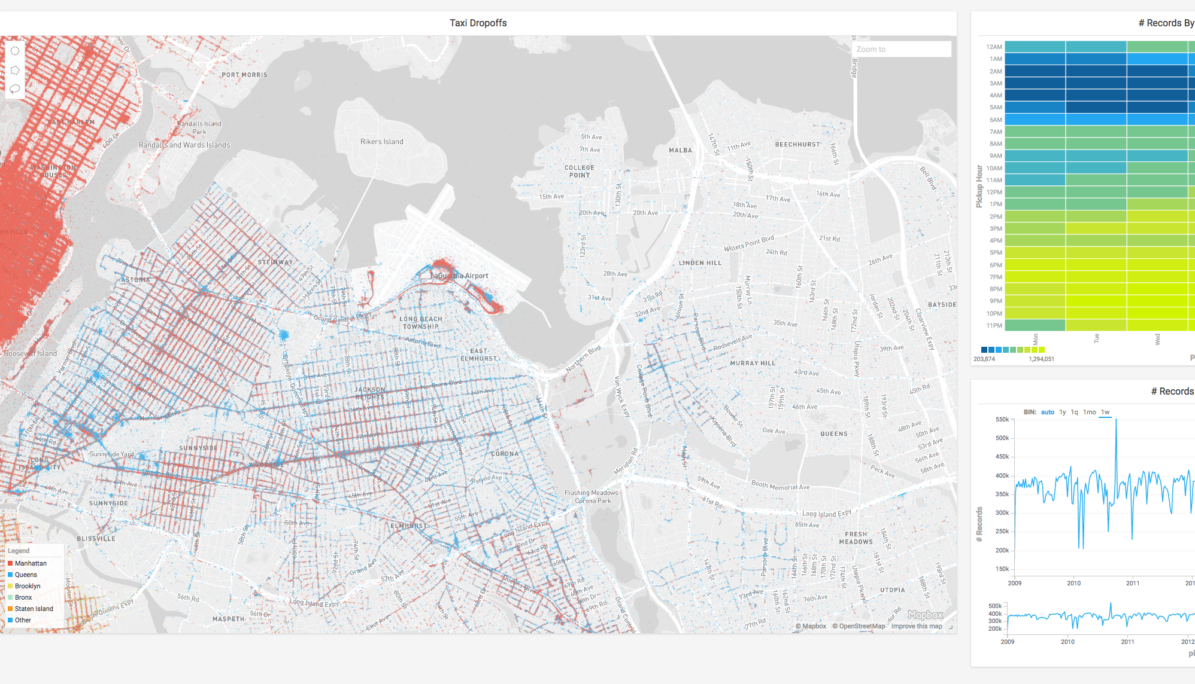

Three Ways to Get Started
OPEN-SOURCE
GitHub Download
COMMUNITY
Website Download
AWS Cloud
ENTERPRISE
Contact MapD Sales
AWS Cloud

